Slide 1
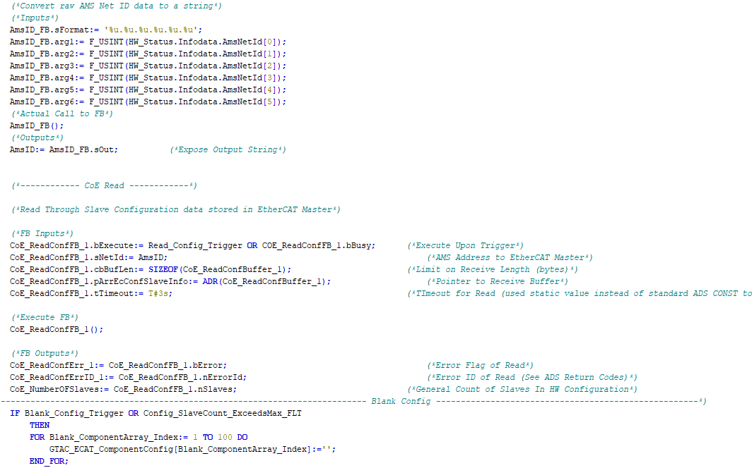

Controls Training
Part 5:
Style Conventions

Slide 2
Intro
The goal of this power point presentation is to set some common style expectations for certain areas of our code. Particularly areas that tend to be customized per application. Although we do like to promote creativity, setting some boundaries helps to ensure consistency, code portability and easier adoption from programmer to programmer.

Slide 3
Clamp Steps
Clamps steps are where we carve out the general clamping and unclamping sequence of our fixtures, we then use the end result of the clamp step code to trigger valve banks associated with clamp groups.
As you may be familiar, the concept of clamp steps have been a widely debated topic for many years at our company. The current general practice is, clamp step style of code is highly suggested on fixtures that have more then 1 clamp / unclamp step. If only one step is required, then the clamp step style may be ignored, and the valve bank code can be triggered with Auto_Run and Weld_Complete (or other Completes are required for the application) directly.

Slide 4
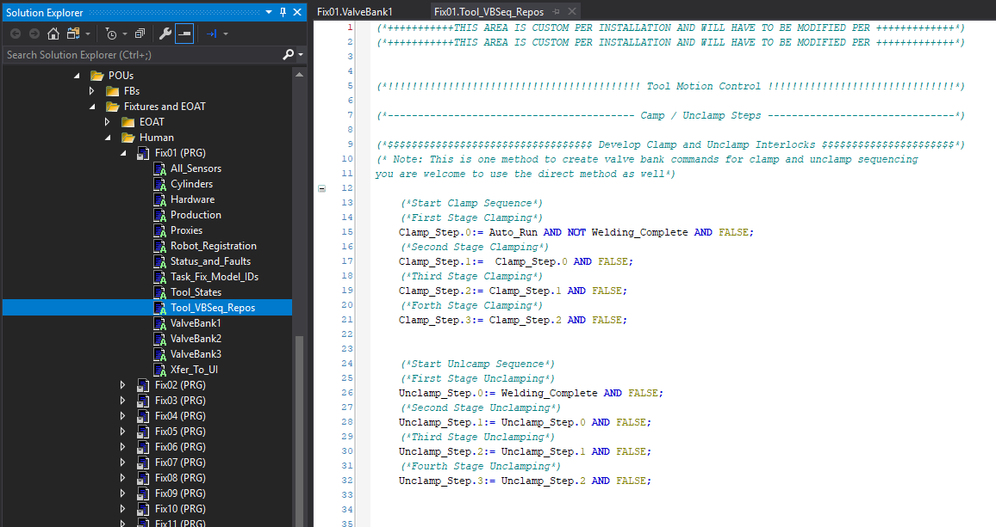
Clamp Steps
This is what the clamp step code looks like in our current (SSCC610) FW out of the box:

Slide 5
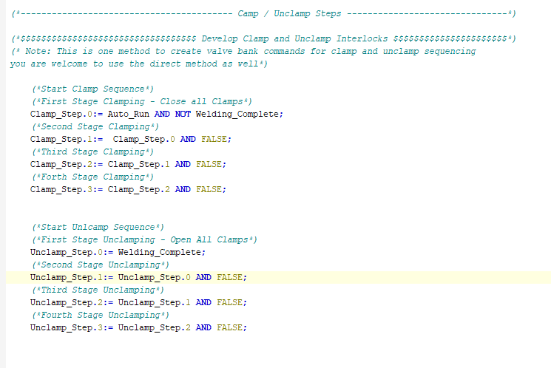
Clamp Steps
If our application used a very simple one step clamp / unclamp sequence, we could use the code as is with a few minor changes.
Comment the clamp / unclamp steps.
Remove the False variables in the clamp and unclamp steps.
Add the clamp and unclamp triggers to our valve bank code. (Next Slide)

Slide 6
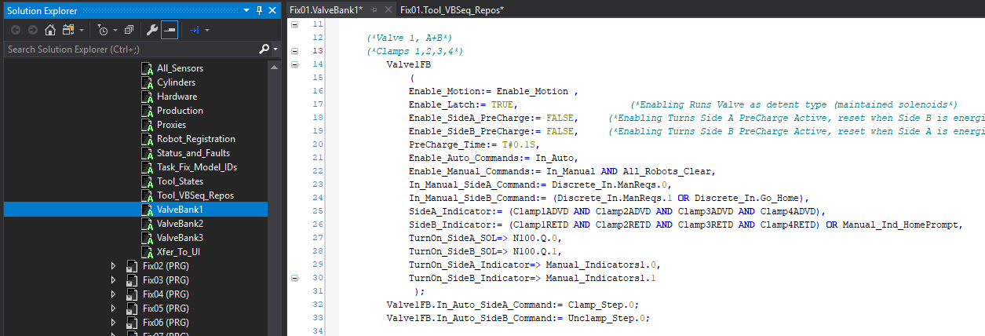
Clamp Steps
From previous slide:
Comment the clamp / unclamp steps.
Remove the False variables in the clamp and unclamp steps.
Add the clamp and unclamp triggers to our valve bank code.

Slide 7
Clamp Steps
Easy right?
In this next example, we will add a secondary step to the sequence.
Our application criteria will be as follows:
Clamping Sequence:
First Step = Send Clamp#3 to work
Second Step = Send Clamp#1,2,4 to work
Un-Clamping Sequence:
First Step = Send Clamp#3 to home
Second Step = Send Clamp#1,2,4 to home
Valving:
Valve#1 is plumbed to clamps 1,2,4
Valve#2 is plumbed to clamp 3

Slide 8
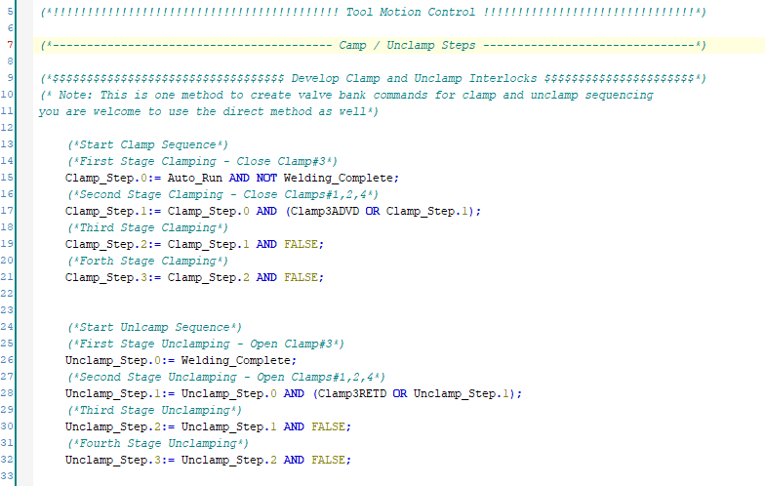
Clamp Steps
For the scenario, here is the clamp step code:

Slide 9
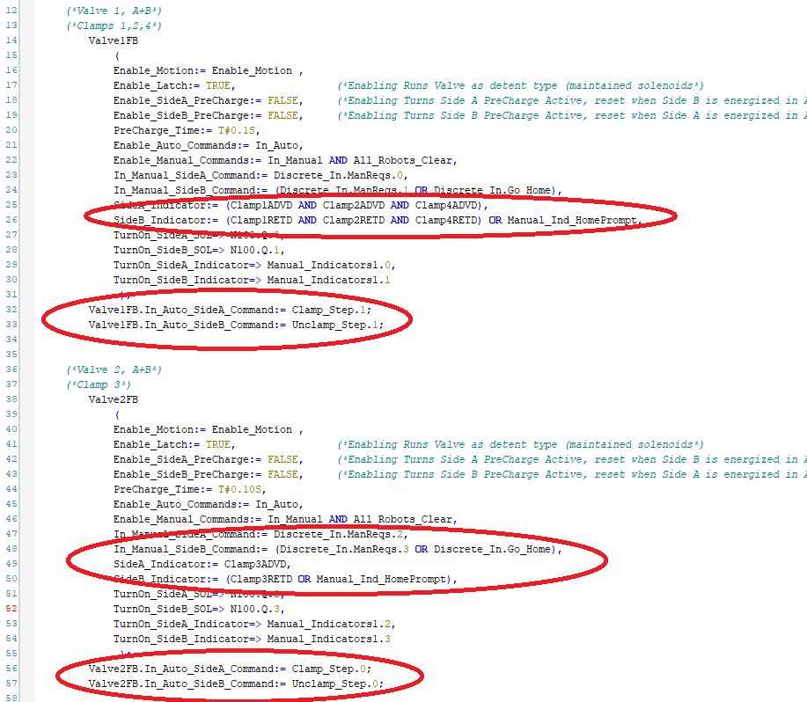
Clamp Steps
And this is the code for the valving:

Slide 10

Thanks for your time

